Slide 1
Coursera capstone ibm data science professional certificate – Best venues to open a traditional Italian restaurant
Keerthana Madhavan
July 2020

Slide 2
Introduction
In this project I will be performing a data analysis on the best places to open an Italian Restaurant – PIZZA! in a populous city Toronto, Canada. Italy is not only known for pizza, but a lot of traditional and rich Mediterranean cuisine. However, during the colonization, traditional Italian food have been modernized, but there exist few natives in Canada who are yearning for good Italian Food. The beauty of Italian food, it just consists of two-four main ingredients that evolve into mouth-watering taste. So now it’s time to get Milan in Toronto.

Slide 3
Business Problem
The objective of this capstone project is to find the most suitable location to open a traditional Italian Cuisine in Toronto, Canada. By using various Data Science and Machine Learning methods and tools such as clustering and folium. This project will provide the best clusters of location to open the restaurant based on the neighborhood data of Toronto.

Slide 4
Data
To Solve this problem, I got access to these data
The Toronto Neighborhood Postal Codes
Access to Latitude and Longitude of Toronto Neighborhoods
Data related to current Italian Restaurant.
Sources of Data
Neighborhood Wikipedia
Geospatial Data.csv
Foursquare API for venue Data

Slide 5
Methodology
Web scraping of
Get Latitude and Longitude using the csv file
Use Foursquare API to get venue data
Group Data by neighborhood and taking the mean of the frequency of occurrence of each venue category
Filter the venue by Italian Restaurants
Perform clustering on the data using k-mean clustering algorithm

Slide 6

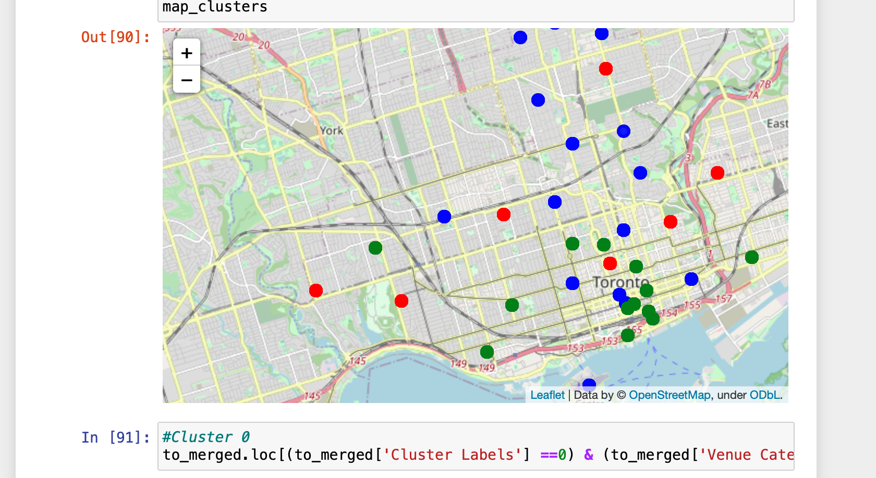
results
Categorized the neighborhoods into 3 clusters:
Green Cluster 0: Neighborhoods with moderate number of Restaurants
Blue Cluster 1: with low number or no existence of a Italian restaurant
Red Cluster 2: With high concentration of Italian Restaurants

Slide 7
discussions
Highest number is in cluster 2 and less numbers in cluster 0
Cluster 1 has very low Italian restaurants in the neighborhoods
There is a lot of Italian restaurants in the spread throughout the city.

Slide 8
recommendations
Most of the Italian Restaurants are in the cluster 2, and then cluster 0
the Neighborhoods First Canadian Place, Underground city in Cluster 1 are like the best places to open a traditional Italian Restaurants.
Looking at nearby venues it seems cluster 0 and 1. I think it might be a good location as there are not a lot of Italian restaurants in these areas. Therefore, this project recommends these neighborhoods to open a hot Italian Restaurant.

Slide 9
Conclusion
Answer to the Business Question: The neighborhoods in cluster 1 are the most preferred locations to open a new Traditional Italian Restaurants
The three clusters will help stakeholder decide where they want to invest and start a restaurant.
Thank you.

